Slide 1
Cancellation status of Hotel booking using ML Algorithm
By
Vinay Charlapally
119ME0036

Slide 2
Objective:
Problem Statement
Given Data
Visualization
Steps done
Chosen model
Conclusion

Slide 3
Problem Statement
Binary Classification, type Predicting hotel reservations that will be cancelled is a classic problem that may be solved by learning and using a variety of data analysis approaches.
Given with a dataset that includes applicant information for hotel reservations as well as the acceptance or denial of the reservation request. The binary classification model's foundation must be established as accurately as possible.

Slide 4
Given Data:
Number of cancelled hotel bookings(Data set)
And Data types
https://raw.githubusercontent.com/Premalatha-success/Datasets/main/hotel_bookings.csv
.

Slide 5
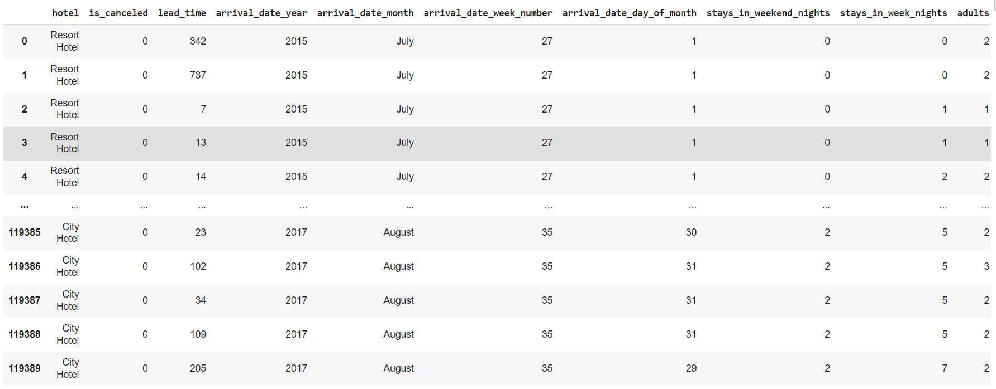
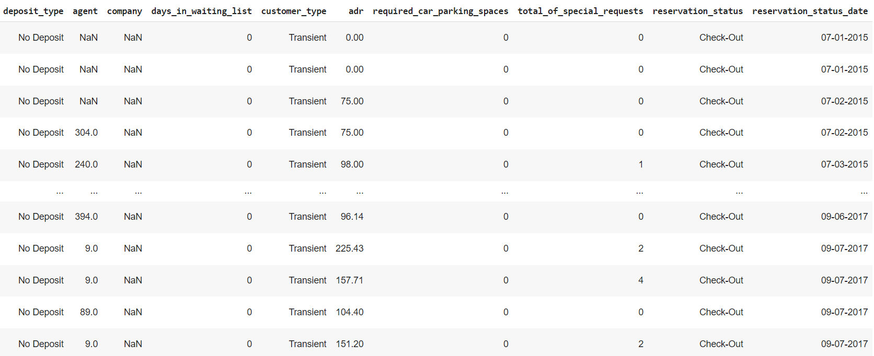
DATA SET

Slide 6
Visualization

Slide 7
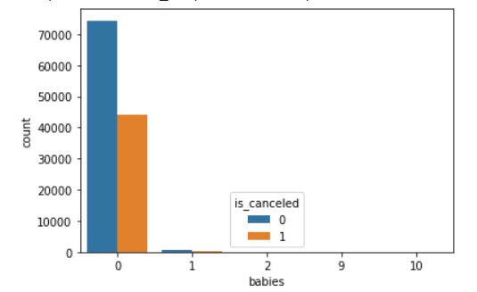
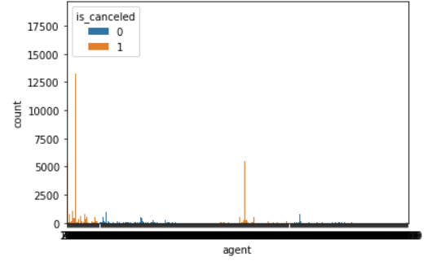
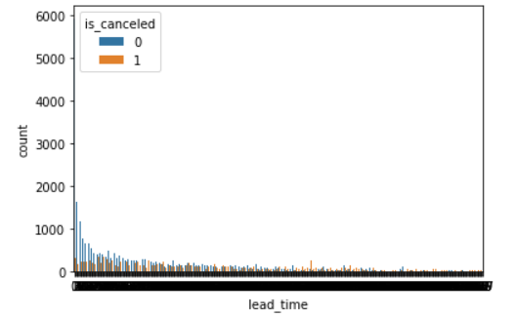
Visualising feature to feature

Slide 8
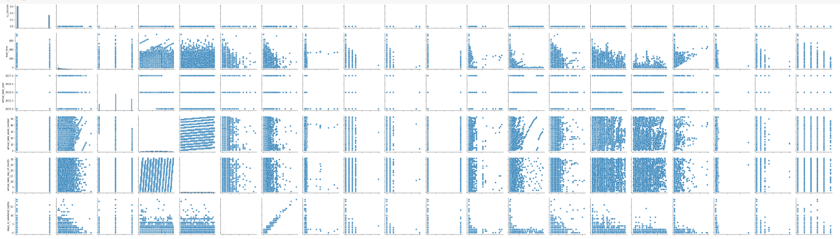
Pair PLot

Slide 9
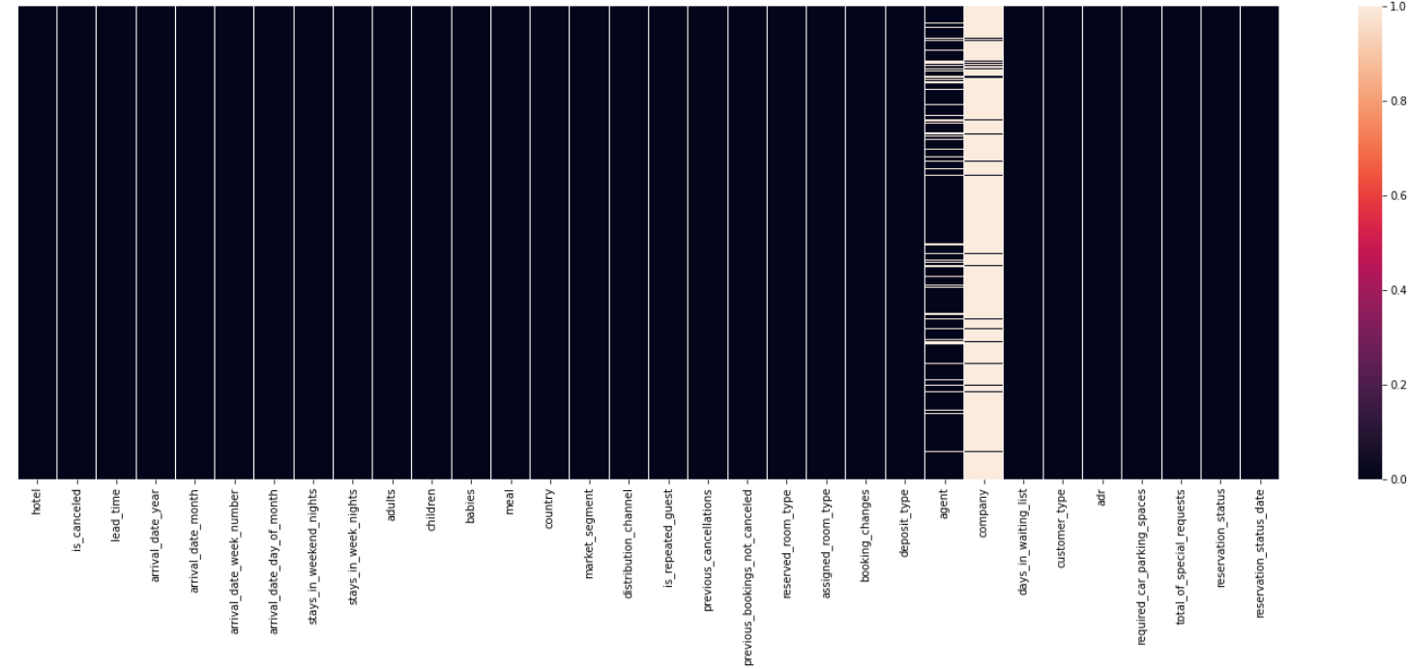
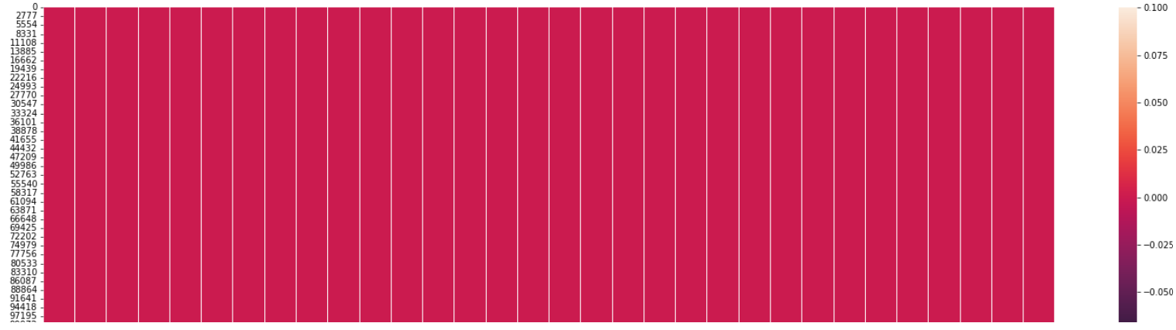
Visualizing Null values

Slide 10
Steps:
•### Step 1: Import the packages numpy,pandas,matplotlib,seaborn,sklearn,train test split,metrics.
•### Step 2:Load the Dataset
•### Step 3:Explore the data-shape,visualization
•### Step 4:X,y-->train data test data > Fit the model with training data predict with the test data

Slide 11
Chosen model:
Decision tree
Why Decision tree ?
Among the four models i have done , the decision tree shows 100% accuracy than any other models .So , that is i chose Decision tree

Slide 12
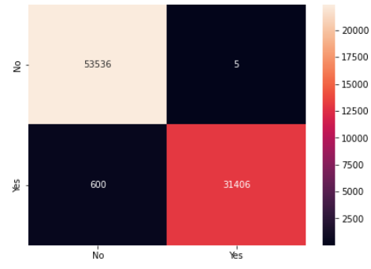
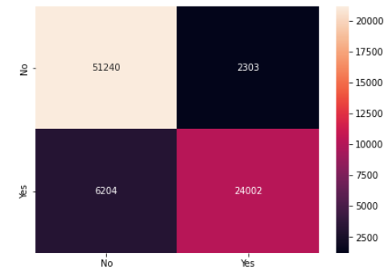
Confusion Matrices
Logistic Regression
KNN Algorithm

Slide 13
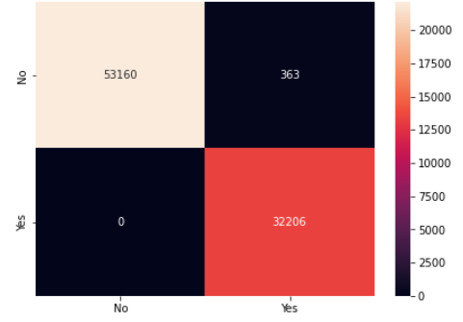
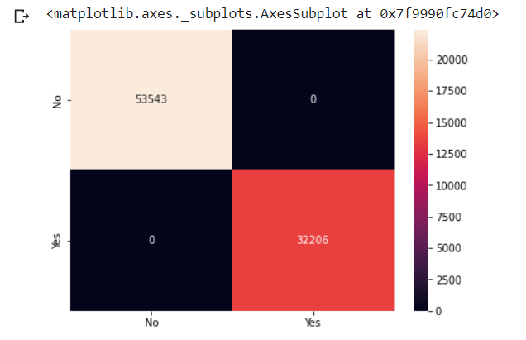
Naive Bayes
Decision Tree Classifier

Slide 14
Conclusion
After the visualization of features in the data using training data and test data, the accuracy and precision of four.
Logistic Regression:
Training data : 0.9899967692915176
Testing data : 0.9891392355585337
K-nearest Neighbours:
Training data : 0.9065248345757602
Testing data : 0.8765111539213223
Naive Baye’s:
Training data : 0.9928565445777943
Testing data : 0.9932155121869504
Decision Tree:
Training data : 1.0
Testing data : 1.0

